Slide 1

算法分析与设计
Analysis and Design of Algorithms
山东大学 · 软件学院
2017年

Slide 2

Graph Algorithms
Part I
  Representations of graphs
    Adjacency-list representation
    Adjacency-matrix representation
  Techniques for searching a graph
    Breadth-first search algorithm (BFS)
    Depth-first search algorithm (DFS)
  Applications of DFS
    Topological sort (for directed acyclic graph)

Slide 3
Graph Algorithms
Part II
  Minimum spanning tree problem (for undirected graph)
    Kruskal’s algorithm
    Prim’s algorithm
Part III
  Single-source shortest paths problem (for directed graph)
    Bellman-Ford algorithm
    Dijkstra’s algorithm
  All-pairs shortest paths problem
    Matrix-multiplication based algorithm
    Floyd’s algorithm
    Johnson’s algorithm

Slide 4
Graph Algorithms
Part IV
  Maximum flow problem (for network)
    Ford-Fulkerson algorithm
    Dinic’s algorithm
  Applications of Max-flow problem
    Maximum matching algorithm for Bipartite graphs

Slide 5





What’s the problem
Basic ideas
The details
Time complexity
The correctness
…
Some concepts

Slide 6
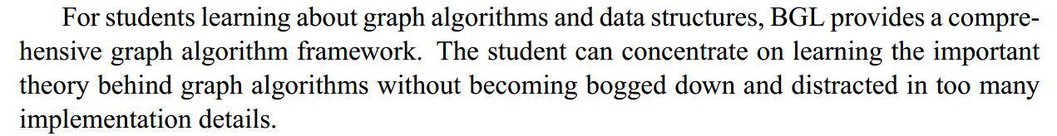

Practicing：BOOST-BGL
http://www.boost.org/

Slide 7
22. Elementary Graph Algorithms
22.1 Graph Basics & Representation

Slide 8
Graph Basics
A Graph G is a pair (V, E), where V is a finite set of objects and E is a set of pairs on V
  Denoted as G = (V, E)
  Element of V: vertex; V: vertex set
  Element of E: edge(arc); E: edge set
Undirected Graph (or Graph): each pair in E is unordered, i.e., if (u, v) ∈E, then (u,v) = (v, u).
Directed Graph: each pair in E is ordered, i.e., for each pair of vertices, u, v, <u, v> ∈ E does not necessarily mean <v, u>∈ E, and vice versa.
Undirected graph: G₁ = ({1, 2, 3}, {(1, 2), (2, 3), (3,1)})
Directed graph: G₂ = ({1, 2, 3}, {<1, 2>, <2, 3>, <3,1>})

Slide 9
Schematic Representation
e₆
e₆
v₁
e₁
e₁
v₂
v₅
v₁
v₂
v₅
e₂
e₃
e₇
e₂
e₃
e₇
e₄
v₄
e₄
v₃
v₆
v₃
v₄
v₆
e₅
e₅
Can you give the representation in format G = (V, E) for above graphs?

Slide 10
Graph Basics
Adjacency: In a graph G = (V, E), if (u, v) ∈ E, we say that vertex v is adjacent to vertex u.
  If G is an undirected graph, vertex u is adjacent to vertex v, too. The adjacency relation is symmetric.
  We also say (u,v) is incident with u and v, vice versa.
  If G is a directed graph and if <u, v> ∈ E, vertex v is adjacent to vertex u, and <u, v> is incident from (or leaves) vertex u to (or enters) vertex v.

Slide 11
Graph Basics
Repeated edges: edges e and f have the same endpoints.
Self-loop: an edge from a vertex to itself.
Simple graph: a graph without repeated edges and without self-loops

Slide 12
Graph Basics (Degree)
Degree of a vertex v:
  For undirected graph:
    Number of edges incident with v.
    Denote as d_{G}(v) or simply, d(v).
  For directed graph:
    In-degree: number of edges entering (or incident to) v.
    Out-degree: number of edges leaving (or incident from) v.
    Denote as id_{G}(v), od_{G}(v) or simply, id(v), od(v) respectively.
Isolated vertex: a vertex whose degree is 0.

Slide 13
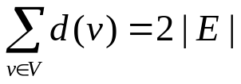
Graph Properties
Theorem 1.1 (Handshaking Lemma)
  Given an undirected graph G = (V, E), , where | E | is the number of edges in G.
  Proof: can you give?
  How about a directed graph? (sum of in-degrees equals to sum of out-degrees, i.e., the number or arcs)
Corollary 1.2
  Given a graph G = (V, E), the number of vertices with odd degrees is even.
  Proof: can you give?

Slide 14
Graph Basics (Cycle)
A cycle is a path p = <v₀, v₁, v₂, …, v_{k}> with v₀ = v_{k}.
  For undirected graph, a simple cycle contains at least 3 edges, that is, k ≥ 3 and v₁, v₂, …, v_{k} are distinct.
  For directed graph, a simple cycle contains at least 1 edge, and v₁, v₂, …, v_{k} are distinct. A self-loop is a cycle of length 1.
Acyclic graph: a graph with no cycles.

Slide 15
Graph Basics (Sub-graph)
A graph G’ = (V’, E’) is a sub-graph of G = (V, E) if V’⊆ V and E’ ⊆ E.
  A graph G’ = (V’, E’) is a vertex induced sub-graph of G = (V, E) if V’⊆ V and E’ = {(u, v) ∈ E: u, v ∈V’}.

Slide 16
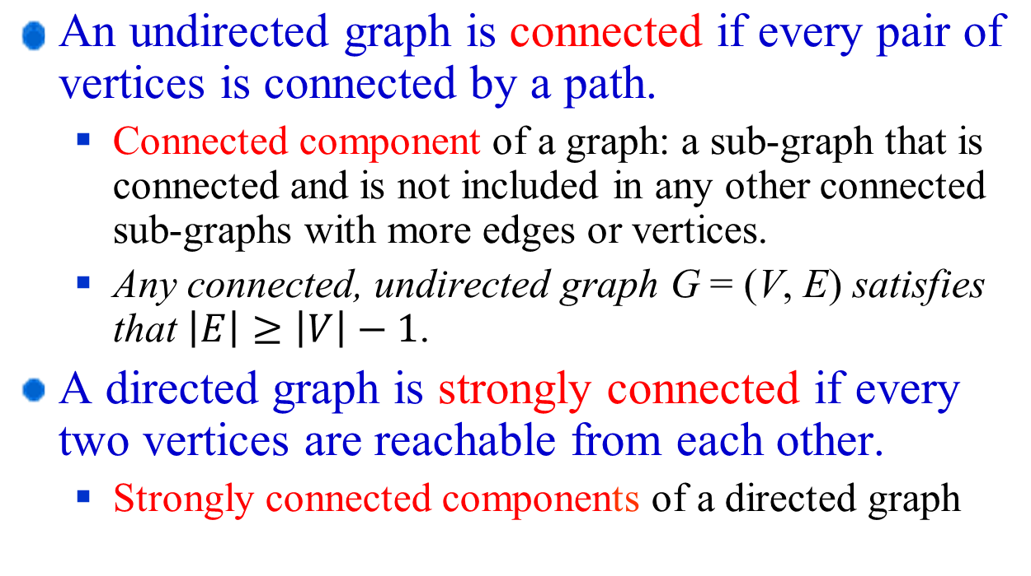
Graph Basics (Connected)

Slide 17
Special graphs
A complete graph is an undirected graph in which every pair of vertices is adjacent.
A bipartite graph is a graph G = (V, E) in which V can be partitioned into two sets V₁ and V₂ such that (u, v) ∈ E implies either u∈V₁ and v∈V₂ or u∈V₂ and v∈V₁.
A forest is an acyclic, undirected graph.
A tree is a connected, acyclic, undirected graph.(|E|=|V|-1)

Slide 18
Sparse vs Dense
Sparse graph: | E | is much less than | V |²
Dense graph: | E | is close to | V |²

Slide 19
Representations of graphs
Two standard ways:
  A collection of adjacency lists
  An adjacency matrix
Sparse graph: | E | is much less than | V |²
  Adjacency-list representation is preferred
Dense graph: | E | is close to | V |²
  Adjacency-matrix representation is preferred

Slide 20
Adjacency-list representation
consist of an array Adj of | V | lists, one for each vertex in V.
adjacency list Adj[u] contains all the vertices v such that there is an edge (u, v) ∈ E, i.e., all vertices that are adjacent to u.
vertices in Adj[u] can be stored in arbitrary order.
sum of the lengths of all the adjacency lists is
  2| E | if G is an undirected graph
  | E | if G is a directed graph
Memory needed to store an adjacency-list representation of a graph is Θ(| V | + | E |)
Weighted graph can be represented by adjacency lists.

Slide 21
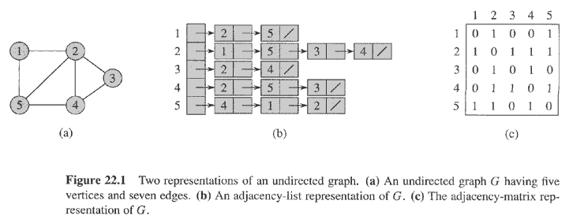
Representations of graphs (Examples)

Slide 22
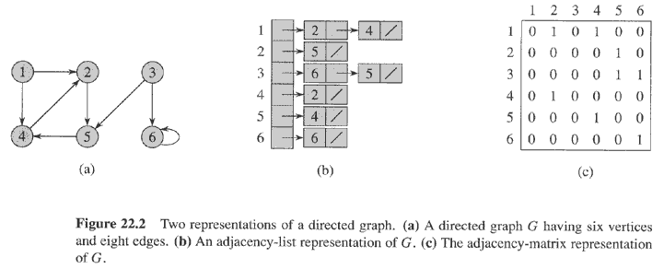
Representations of graphs (Examples)

Slide 23
Adjacency-list representation (advantage vs disadvantage)
Advantage:
  when the graph is sparse, uses only O(| V | + | E |) memory.
Disadvantage:
  no quicker way to determine if a given edge (u, v) is present in the graph than to search for v in the adjacency list Adj[u]. O(| V |)

Slide 24
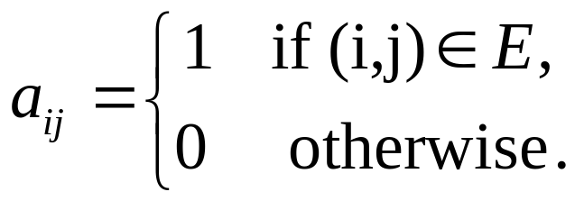
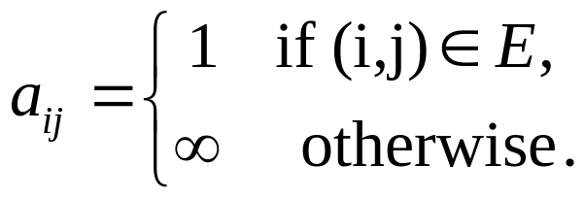
Adjacency-matrix representation
Consists of a | V | × | V | matrix A = (a_{ij}) such that
or
A is symmetric along the main diagonal for undirected graphs, that is, A^{T} = A.
For directed graph, generally, A^{T} ≠ A. Can you imagine what directed graph satisfies A^{T} = A?
Adjacency-matrix can be used to represent weighted graphs.

Slide 25
Adjacency-matrix representation (Advantage vs disadvantage)
Advantage:
  Easily or quickly to determine if an edge is in the graph or not. O(1)
Disadvantage:
  Uses more memory to store a graph. O(| V |²)

Slide 26
22. Elementary Graph Algorithms
22.2 Breadth-First Search Algorithm
22.3 Depth-First Search Algorithm

Slide 27
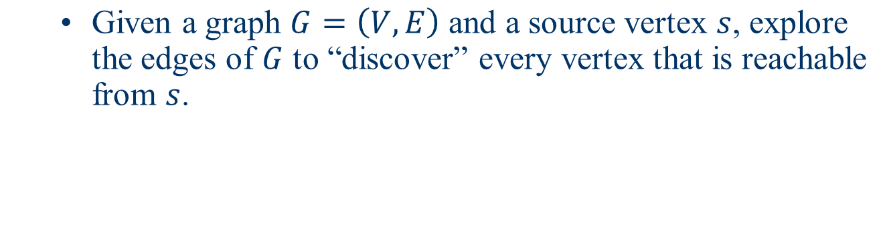
The Problem
d
e
b
c
s
a

Slide 28
The Basic Ideas of BFS
  Each time, search as many vertices as possible.
  Visit the vertices as follows:
    Visit all vertices at distance 1
    Visit all vertices at distance 2
    Visit all vertices at distance 3
    … …

Slide 29
The Details for BFS
Given a graph G = (V, E), the BFS returns:
  d[v], the distance from s to v
  π[v] , the predecessor of v in the search, which can be used to derive a path from s to vertex v.
In addition to the two arrays d[v] and π[v], BFS also uses another array color[v], which has three possible values:
  WHITE: represented “undiscovered” vertices;
  GRAY: represented “discovered but not processed” vertices;
  BLACK: represented “processed” vertices.

Slide 30
The Details for BFS (continued)
Initially, s is made GRAY, others are colored WHITE.
After a gray vertex is processed, its color is changed to black, and the color of all white neighbors is changed to gray.
Gray vertices are kept in a queue Q.

Slide 31
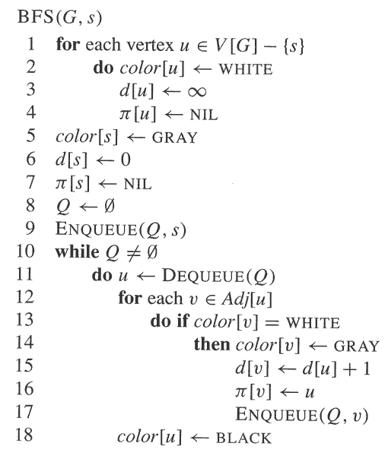
The Details for BFS (continued)
G is given by its adjacency-lists.
Initialization:
  First Part: lines 1 – 4
  Second Part: lines 5 - 9
Main Part: lines 10 – 18
Enqueue(Q, v): add a vertex v to the end of the queue Q
Dequeue(Q): Extract the first vertex in the queue Q

Slide 32
An Example for BFS
source vertex: s
b
c
a
s
f
e
d

Slide 33
Example (continued)
Initialization
vertex u
s a b c d e f
color[u]
d[u]
π[u]
G W W W W W W
0 ∞ ∞ ∞ ∞ ∞ ∞
NIL NIL NIL NIL NIL NIL NIL
Q = <s>
(put s into Q (discovered),
mark s gray (unprocessed))
b
c
a
s
0
f
e
d

Slide 34
Example (continued)
b
1
c
While loop, first iteration
  Dequeue s from Q. Find Adj[s]=<b, e>
  Mark b,e as “G”
  Update d[b], d[e], π[b], π[e]
  Put b, e into Q
  Mark s as “B”
Q=<b, e>
a
s
0
f
e
d
1
vertex u
s a b c d e f
color[u]
d[u]
π[u]
B W G W W G W
0 ∞ 1 ∞ ∞ 1 ∞
NIL NIL s NIL NIL s NIL

Slide 35
Example (continued)
b
1
c
2
While loop, second iteration
  Dequeque b from Q, find Adj[b]=<s, a, c, f>
  Mark a, c, f as “G”,
  Update d[a], d[c], d[f], π[a], π[c],π[ f]
  Put a, c, f into Q
  Mark b as “B”
Q=<e, a, c, f>
a
2
s
0
f
2
e
d
1
vertex u
s a b c d e f
color[u]
d[u]
π[u]
B G B G W G G
0 2 1 2 ∞ 1 2
NIL b s b NIL s b

Slide 36
Example (continued)
While loop, third iteration
  Dequeque e from Q, find Adj[e]=<s, a, d, f>
  Mark d as “G”, mark e as “B”
  Update d[d], π[d],
  Put d into Q
Q=<a,c,f,d>
2
b
1
c
a
2
s
0
f
2
e
d
2
1
vertex u
S a b c d e f
color[u]
d[u]
π[u]
B G B G G B G
0 2 1 2 2 1 2
NIL b s b e s b

Slide 37
Example (continued)
While loop, fourth iteration
  Dequeque a from Q, find Adj[a]=<b, e>
  mark a as “B”
Q=<c, f, d>
2
b
1
c
a
2
s
0
f
2
e
d
2
1
vertex u
s a b c d e f
color[u]
d[u]
π[u]
B B B G G B G
0 2 1 2 2 1 2
NIL b s b e s b

Slide 38
Example (continued)
While loop, fifth iteration
  Dequeque c from Q, find Adj[c]=<b, d>
  mark c as “B”
Q=<f, d>
2
b
1
c
a
2
s
0
f
2
e
d
2
1
vertex u
s a b c d e f
color[u]
d[u]
π[u]
B B B B G B G
0 2 1 2 2 1 2
NIL b s b e s b

Slide 39
Example (continued)
2
While loop, sixth iteration
  Dequeque f from Q, find Adj[f]=<b,e>
  mark f as “B”
Q=<d>
2
b
1
c
a
2
s
0
f
2
2
e
d
2
1
vertex u
s a b c d e f
color[u]
d[u]
π[u]
B B B B G B B
0 2 1 2 2 1 2
NIL b s b e s b

Slide 40
Example (continued)
2
While loop, seventh iteration
  Dequeque d from Q, find Adj[d]=<c,e>
  mark d as “B”
Q is empty
2
b
1
c
a
2
s
0
f
2
2
e
d
2
1
vertex u
s a b c d e f
color[u]
d[u]
π[u]
B B B B B B B
0 2 1 2 2 1 2
NIL b s b e s b

Slide 41
Example (continued)
2
b
1
c
2
While loop, eighth iteration
Since Q is empty, stop
a
2
s
0
f
2
2
e
d
2
1
vertex u
s a b c d e f
color[u]
d[u]
π[u]
B B B B B B B
0 2 1 2 2 1 2
NIL b s b e s b

Slide 42
Example (continued)
Question:
How do you construct a path
from s to any vertex by using
the following table?
2
b
1
c
2
a
2
s
0
f
2
2
e
d
2
1
vertex u
s a b c d e f
color[u]
d[u]
π[u]
B B B B B B B
0 2 1 2 2 1 2
NIL b s b e s b

Slide 43

Analysis of BFS
We assume that it takes one unit time to test the color of a vertex, or to update the color of a vertex, or to compute d[v] = d[u] + 1, or to set π[v] = u, or to enqueue, or to dequeue.
The following analysis is valid for connected graphs.
  The initialization requires Θ (V) time units.
  In the while loop, each vertex u is en-queued and de-queued exactly once. So, each adjacency list Adj[u] is scanned exactly once after u is de-queued. So scanning the adjacency lists needs time Θ(E).
Total time is: T(V, E) = Θ(V+E).

Slide 44

Analysis of BFS
BFS creates a breadth-first tree F = (V, E_{f}), where
E_{f} = {(π[u], u)| where π[] is computed in the BFS(G, s) calls}
1
2
b
c
2
a
2
s
0
f
2
2
e
d
2
1
The red edges form a tree

Slide 45

Analysis of BFS
The breadth-first tree is in fact a shortest path tree.
To prove this conclusion, we need to prove the following two parts:
    Prove that the BFS algorithm outputs the correct distance d[]
    Prove that the paths obtained by using the array π[] are shortest.
We will prove the correctness of the Dijkstra’s algorithm later, which implies the correctness of the BFS algorithm.

Slide 46

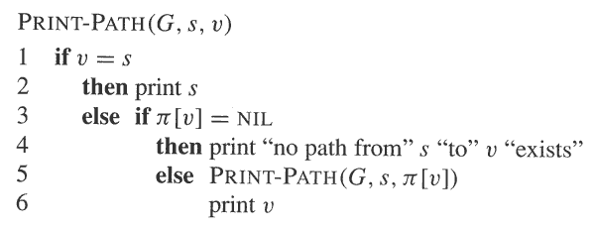
Analysis of BFS

Slide 47

Analysis of BFS
We can modify BFS so that it returns a forest.
More specifically, if the original graph is composed of connected components C₁, C₂, …,C_{k}, then BFS will return a tree corresponding to each C_{i}.

Slide 48
Analysis of BFS
BFS_GENERAL(G)
1 for each vertex u ∈V
2 color[u]←WHITE;
3 d[u]← ∞;
4 π[u]←NIL;
5 for each vertex u ∈V
6 if d[u] = ∞
7 then BFS(G, u);

Slide 49
The Basic Ideas of DFS
An example used to illustrate the basic idea:
u
v
w
x
y
z

Slide 50
The Details for DFS
color[u]: the color of each vertex u
  WHITE means undiscovered
  GRAY means discovered but not finished processing
  BLACK means finished processing.
π[u]: the predecessor of u, indicating the vertex from which u is discovered.
d[u]: discovery time, a counter indicating when vertex u is discovered.
f[u]: finishing time, a counter indicating when the processing of vertex u (and the processing of all its descendants ) is finished.

Slide 51
The Details for DFS Algorithm
DFS(G)
1 for each vertex u∈V[G]
2 do color[u] ← WHITE
3 π[u] ← NIL
4 time ← 0
5 for each vertex u∈V[G]
6 do if color[u] = WHITE
7 then DFS-VISIT(u)
DFS-VISIT(u)
1 color[u] = GRAY
2 d[u] ← time ← time +1
3 for each v ∈ Adj[u]
4 do if color[v] = WHITE
5 then π[v] ← u
6 DFS-VISIT(v)
7 color[u] = BLACK
8 f[u] ← time ← time + 1
a global variable
d[u] : discovery time
f[u]: finishing time

Slide 52
An Example for DFS
a
d
b
c
g
e
f

Slide 53
An Example for DFS
a
1/
d
b
c
g
e
f

Slide 54
An Example for DFS
1/
a
d
2/
b
c
g
e
f

Slide 55
An Example for DFS
1/
a
d
2/
b
3/
c
g
e
f

Slide 56
An Example for DFS
1/
a
d
2/
b
3/
c
g
e
f
4/

Slide 57
An Example for DFS
1/
a
d
2/
b
3/
c
g
e
f
4/5

Slide 58
An Example for DFS
1/
a
d
2/
b
3/6
c
g
e
f
4/5

Slide 59
An Example for DFS
1/
a
d
b
2/7
3/6
c
g
e
f
4/5

Slide 60
An Example for DFS
1/8
a
d
2/7
b
3/6
c
g
e
f
4/5

Slide 61
An Example for DFS
1/8
a
9/
d
2/7
b
3/6
c
g
e
f
4/5

Slide 62
An Example for DFS
1/8
a
9/
d
2/7
b
3/6
c
g
e
10/
f
4/5

Slide 63
An Example for DFS
1/8
a
9/
d
2/7
b
3/6
c
g
e
10/11
f
4/5

Slide 64
An Example for DFS
1/8
a
9/
d
2/7
b
3/6
12/
c
g
e
10/11
f
4/5

Slide 65
An Example for DFS
1/8
a
9/
d
2/7
b
3/6
c
g
12/13
e
10/11
f
4/5

Slide 66
An Example for DFS
1/8
a
9/14
d
2/7
b
12/13
3/6
c
10/11
g
e
f
4/5

Slide 67

Analysis of DFS
DFS(G)
for each u in V
do color[u]←white;
  π[u]←NIL;
time=0; Θ(V)
for each u in V
do if color[u]= white // Θ(V)
then DFS-VISIT(u); //T(u)
DFS-VISIT(u)
color[u]=gray;
time=time+1;
d[u]=time; // Θ(1)
for each v ∈adj[u]
do if color[v]=white
then π[v]=u; // Θ(|adj[u]|)
DFS-VISIT(v);
color[u]=black;
time=time+1;
f[u]=time; // Θ(1)

Slide 68
Analysis of DFS
Since each vertex is grayed exactly once, for each u, DFS-VISIT(u) is called exactly once.
During DFS-VISIT(u) , Adj[u] is scanned exactly once, so T(u)= Θ(1 + |Adj[u]|).
So, ∑ T(u) = Θ(V+E)
Hence, total time T(V, E)= Θ(V+E)

Slide 69

Analysis of DFS
Given a graph G, it traverses all vertices of G and
Constructed a collection of rooted trees
Outputs three arrays: d[], f[], π[]
Note: forest is stored in array π[], the π[] value of a root is null.
DFS forest: DFS creates a depth-first forest
F = (V, E_{f}),
where E_{f} = {(π[u], u)| u∈ V , π[u] ≠NIL }
π[] is computed in the DFS-VISIT calls

Slide 70
Problem
Consider: how does the order of vertices in adjacency list influence the result of DFS?

Slide 71
Property 1 of DFS
Definition: In a rooted forest(especially, DFS forest), any vertex u on the simple path from the root to v is called an ancestor of v, and v is called a descendant of u.
u = π[v] if and only if DFS-VISIT(v) was called during a search of u’s adjacency list. u is called the parent of v.
Vertex v is a descendant of vertex u in the depth-first forest if and only if v is discovered during the time in which u is gray
.

Slide 72
The Details for DFS Algorithm
DFS(G)
1 for each vertex u∈V[G]
2 do color[u] ← WHITE
3 π[u] ← NIL
4 time ← 0
5 for each vertex u∈V[G]
6 do if color[u] = WHITE
7 then DFS-VISIT(u)
DFS-VISIT(u)
1 color[u] = GRAY
2 d[u] ← time ← time +1
3 for each v ∈ Adj[u]
4 do if color[v] = WHITE
5 then π[v] ← u
6 DFS-VISIT(v)
7 color[u] = BLACK
8 f[u] ← time ← time + 1
a global variable
d[u] : discovery time
f[u]: finishing time

Slide 73
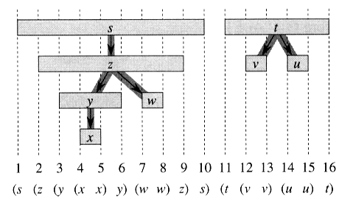
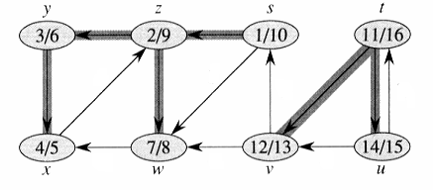
Property 2 of DFS
The discovery and finishing time have parenthesis structure.
In detail, if we use “(u” to represent the discovery of u, and “u)” the finishing of u, then the history of discoveries and finishings makes a well-formed expression in the sense that the parentheses are properly nested
(a)
(b)

Slide 74
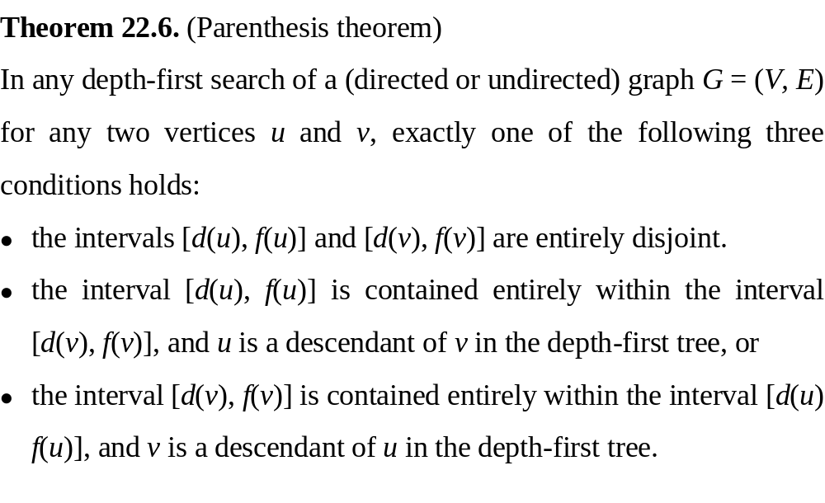
Properties of DFS (2)
Another way of stating the condition of parenthesis structure:

Slide 75
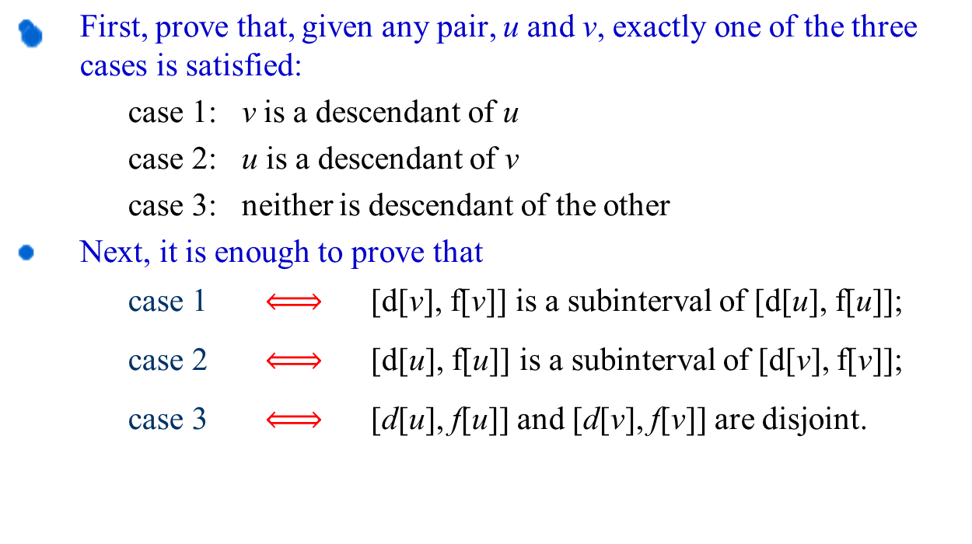
Proof:

Slide 76
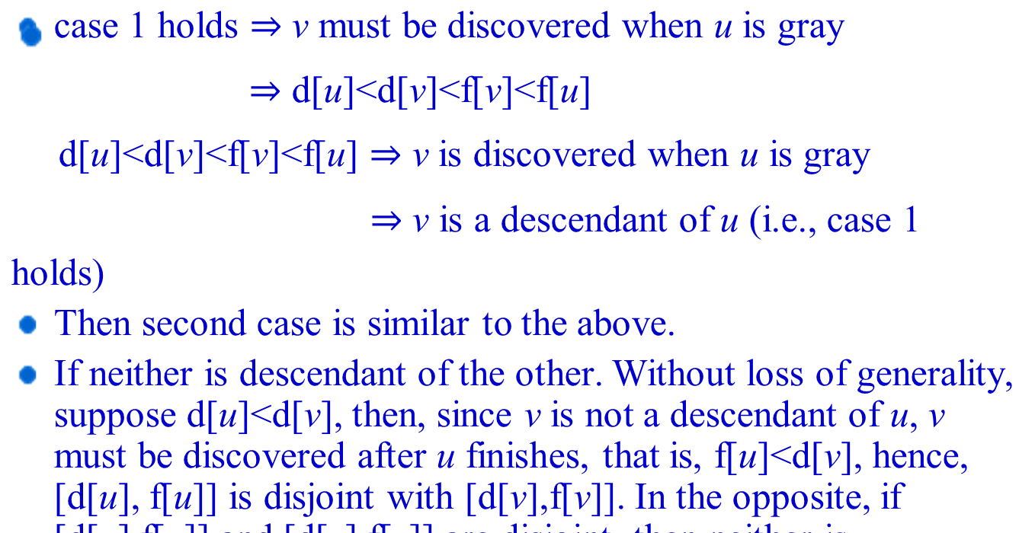
Proof: (Continued)

Slide 77
Nesting of descendants’ intervals
Corollary 22.8: Vertex v is a proper descendant of vertex u in the depth-first forest for a graph G if and only if d[u]< d[v] < f[v] < f[u].

Slide 78
Property 3 of DFS
Theorem 22.9 (White-Path Theorem)
In a depth-first forest of a (directed or undirected) graph G = (V, E), v is a descendant of u
at time d[u], v can be reached from u along a path consisting entirely of white vertices.

Slide 79
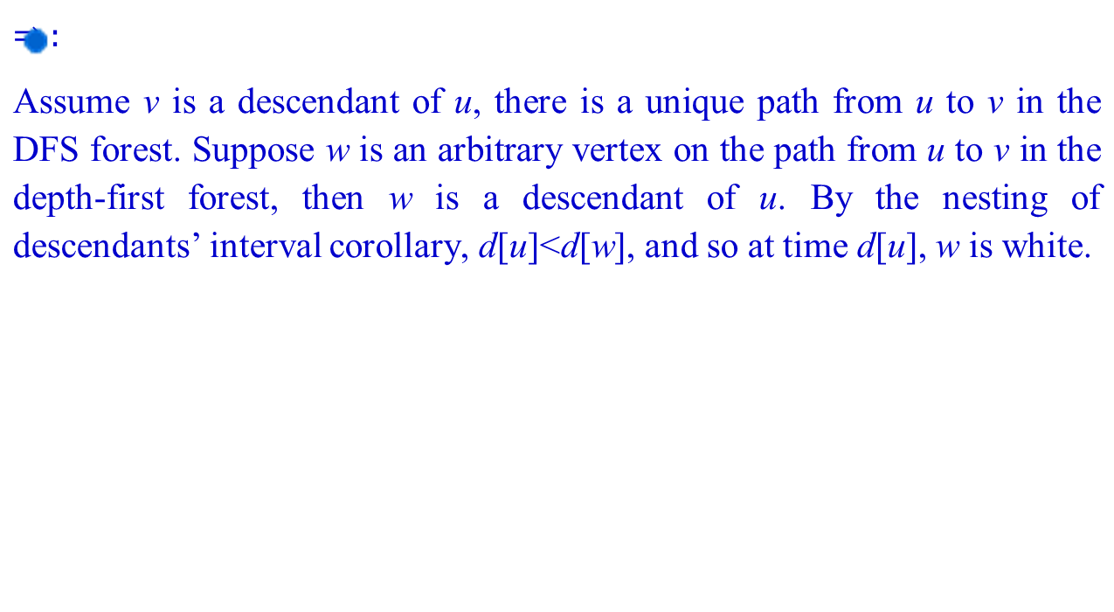
Proof:

Slide 80
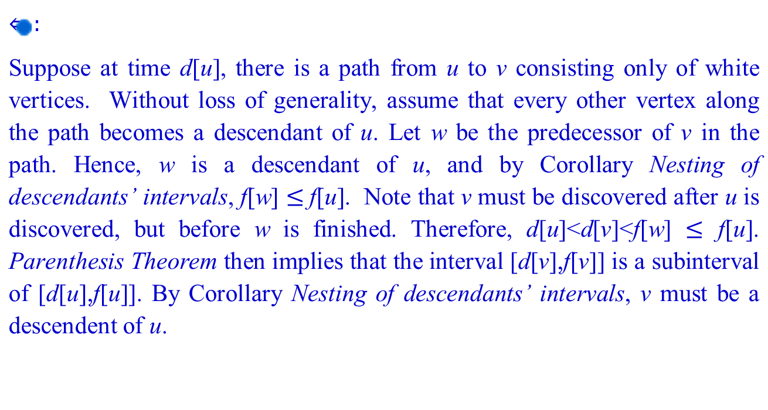
Proof of White-path theorem

Slide 81
Property 4
Classification of Edges (1. directed graph)
Let G_{π} = (V, E_{π}) be the depth-first forest produced by a depth first search on directed graph G = (V, E), then the edges of G can be classified into four categories(the non-tree edges are classified according to the relationship with the end points):
  Tree edges: edges in G_{π} 。
  Back edges: edges (u, v) connecting a vertex u to an ancestor v. Self-loops in directed graphs are considered to be back edges.
  Forward edges: those non-tree edges (u, v) connecting a vertex u to a descendant v.
  Cross edges: all other edges. They can go between vertices in the same depth-first tree as long as neither vertex is ancestor of the other, or they go between vertices in different trees.
For each pair of vertices, u and v, there are only three probabilities between them: u is descendant of v, opposite, or neither.

Slide 82

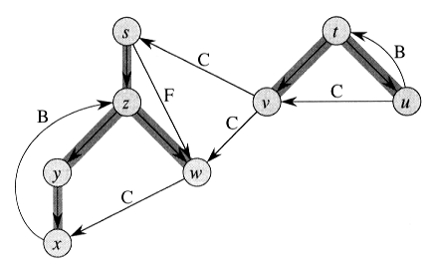
Classification of Edges (Directed graph)

Slide 83
Observation (directed graph)
In a depth-first search, an edge (u, v) can be classified according to the color of v when (u, v) is first explored:
  WHITE indicates a tree edge
  GRAY indicates a back edge
  BLACK indicates a forward or cross edge
    How to distinguish a forward edge and a cross edge?
      d[u] < d[v] means a forward edge
      d[u] > d[v] means a cross edge
Accordingly, DFS algorithm can be modified to classify edges as it encounters them. How?

Slide 84
Classification of Edges (2. undirected graph)
In an undirected graph, (u, v) and (v, u) are in fact the same edge. In such a case, the edge is classified as the first type.
Theorem 22.10 In a depth-first search of an undirected graph G, every edge of G is either a tree edge or a back edge.
  Proof: let (u, v) be an arbitrary edge of G, and without loss of generality, suppose d[u]<d[v]. Since v is on u’s adjacency list, v must be discovered and finished before we finish u (while u is gray).
  If the edge (u, v) is explored first in the direction from u to v, then v is white until that time. Thus, (u, v) becomes a tree edge.
  If (u, v) is explored first in the direction from v to u, then (u, v) is a back edge, since u is still gray at the time the edge (u, v) is first explored.
u
w
v

Slide 85
Classification of Edges (Undirected)
1/8
a
9/14
d
2/7
b
12/13
3/6
c
10/11
g
e
f
4/5

